Slide 1
Unsupervised Learning Capstone
Classifying Mall Customers
Matthew Kehoe, January 2023

Slide 2
General challenges facing today’s malls
Foot traffic is down. Visits to indoor malls, open-air lifestyle centers, and outlet malls declined 7.4% in 2023.
Shopping habits are changing. Total retail sales will rise only 3.3% in 2023, while ecommerce sales will increase 10.0%.
There’s a lot of empty real estate. As revenues decline, retailers are unable to keep up with rent and operating costs and are closing hundreds of stores.
Source: Insider Intelligence, Market Research

Slide 3
Classifying customers through Kaggle dataset
Kaggle dataset: data from 2,000 customers from loyalty cards at checkout (anonymized to protect privacy).
Data contains four continuous variables including annual income, age, customer id, and spending score.
There are five categorical variables for city size, gender, marital status, level of education, and occupation.
Dataset: Customer Clustering Data

Slide 4
The Kaggle dataset
Spending score is a number from 0-100 which predicts spending potential. Higher score translates to high spending potential.
Annual income ranges from $35,832 to $309,364 (US dollars).
Age range is from 18 years old to 76 years old.
Occupation includes unskilled workers, skilled workers, and managers.
Level of education is from high school to graduate school.

Slide 5
Unsupervised Machine Learning Problem
Can we classify the customers into groups based on the information available?
Three Continuous Variables:
Annual Income
Age
Spending Score
Unsupervised ML Problem: What is the optimal number of clusters? What do customers in these clusters have in common?

Slide 6
Exploring and Cleaning the dataset

Slide 7
Data Exploration: size of dataset
The shape of the dataset is (2000,9). So, there are 2,000 records and 9 columns.
Three of the nine columns are continuous variables representing income, age, and spending score. We can use these for clustering.
Five of the nine columns are categorical variables. We will use these for exploratory data analysis and visualization.
The final column is customer id. We won’t analyze this feature.

Slide 8
Data Cleaning: removing or replacing data
The dataset has already been cleaned, so we don’t need to perform any further analysis.
All nine columns have relevant data. We don’t need to replace null values.

Slide 9
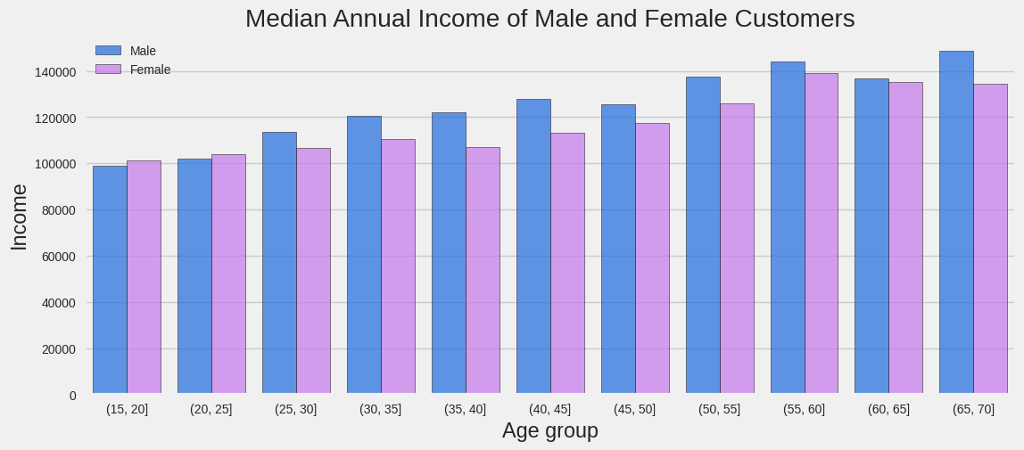
Data Exploration: annual income by gender and age

Slide 10
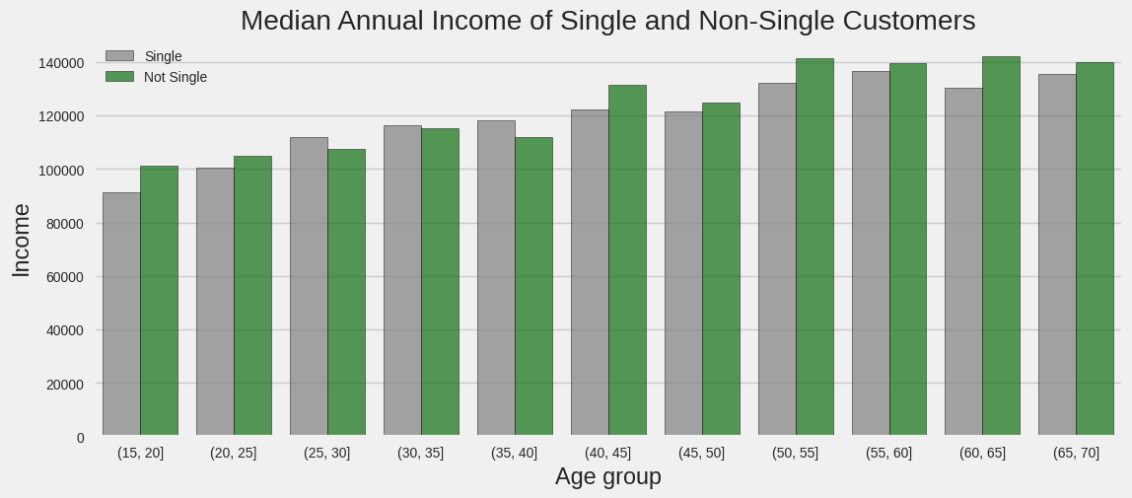
Data Exploration: annual income by marital status and age

Slide 11
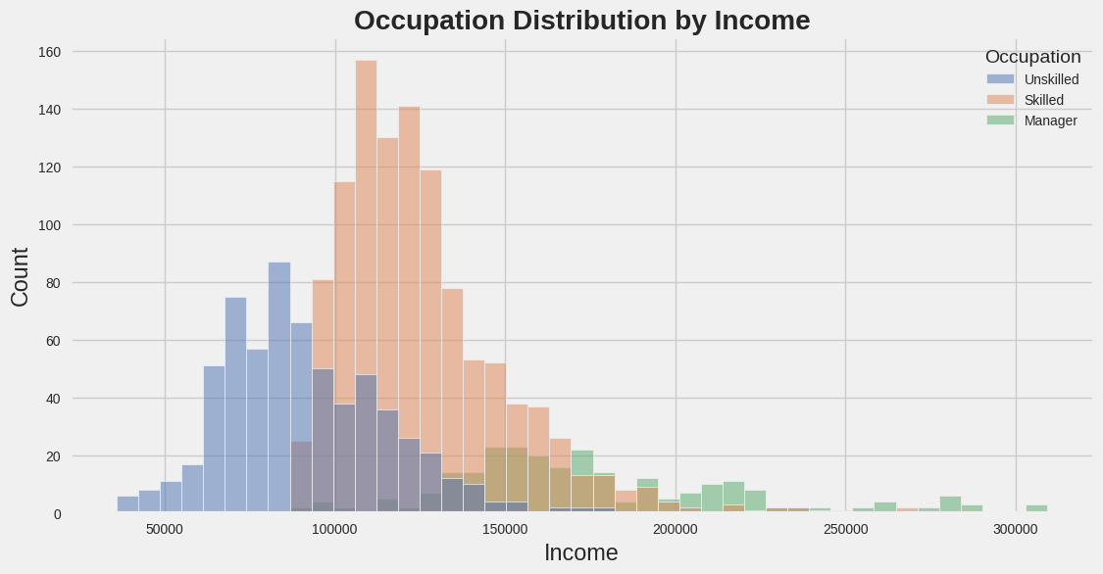
Data Exploration: annual income by occupation

Slide 12
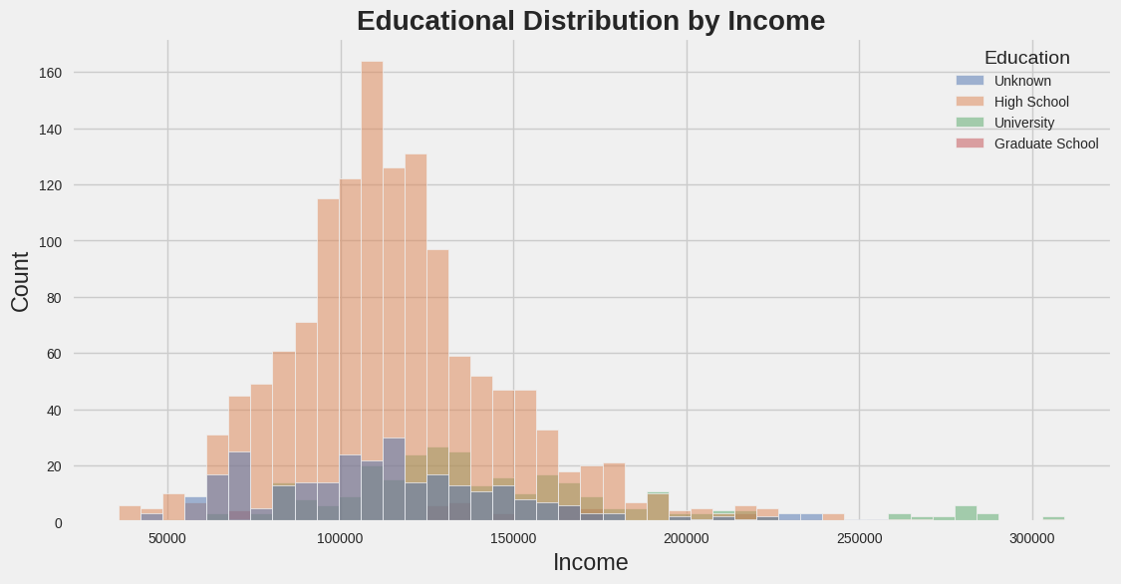
Data Exploration: annual income by education

Slide 13
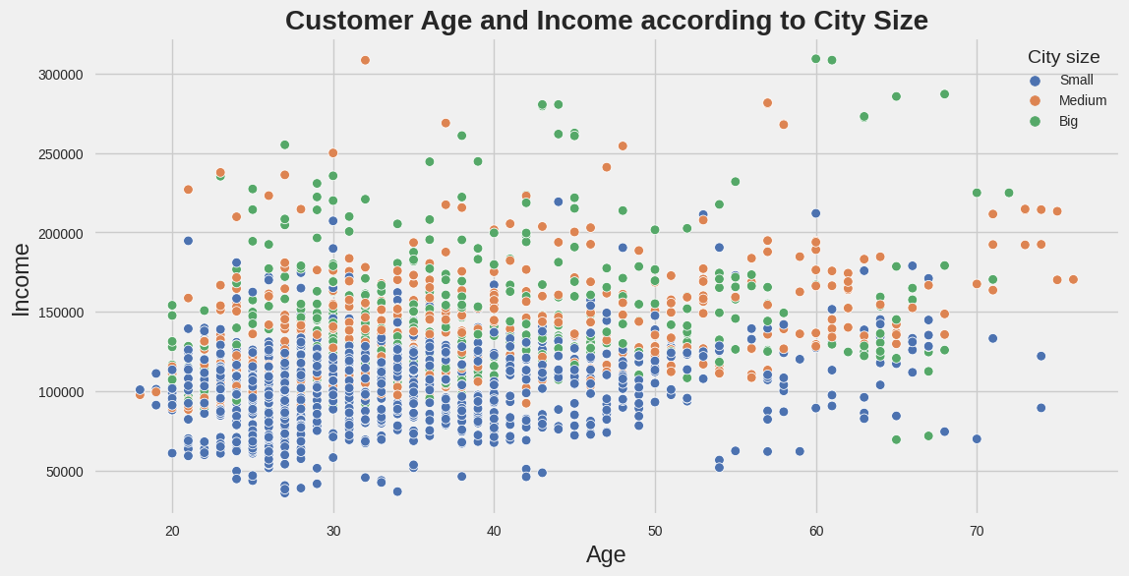
Data Exploration: age and income by city size

Slide 14
Model preparation

Slide 15
Model Preparation: Correlation between columns
My dataset has the shape of (2000,9) with 9 features.
I now want to investigate if the features are highly correlated.
To do this, I will use a heatmap to visualize correlations between features.

Slide 16
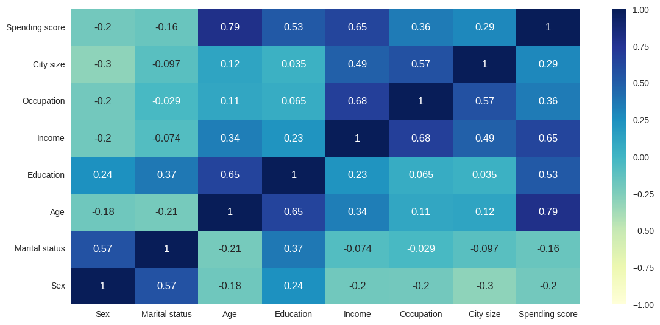
Model Preparation: Heatmap

Slide 17
Model Preparation: features for clustering
The heatmap shows that age, education, income, occupation, and city size are correlated with spending score.
To setup my unsupervised ML problem I will keep the continuous variables.
Feature Variables for Clustering:
Annual Income
Age
Spending Score

Slide 18
Model Preparation: using heuristics
Before I begin using unsupervised ML techniques, I need to establish heuristics from prior data analysis.
It seems sensible that a high annual income would increase spending score and that highly educated individuals would have a high income.
At the very least, my model should separate consumers into two groups:
Group 1: Low income, skill, and education. Low spending score.
Group 1: High income, skill, and education. High spending score.

Slide 19
Model Selection, Clustering, and Dimensionality Reduction

Slide 20
Clustering
A single, continuous target variable with three continuous features sounds like a great case for regression.
A random forest is my first choice, as they handle both regression and classification issues well.
This is a regression problem, so I will also try linear regression.
A gradient boosting regressor is my third option.
The KNN algorithm can look at the k-nearest neighbors for regression.
As a final model, I will try a Support Vector Regressor.

Slide 21
Model Performance
Best performers, ranked:
K-Means
Gaussian Mixture Model
DBSCAN
I built an optimized version the Gradient Boosting Regressor using parameters suggested by GridSearchCV. However, it didn’t beat the KNN Regressor.

Slide 22
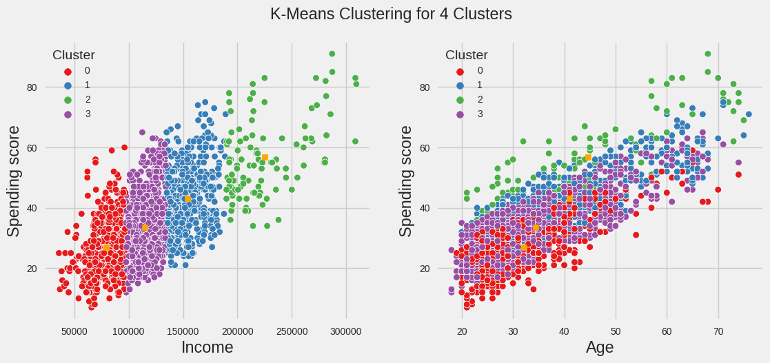
Model Results: K-Means Clustering

Slide 23
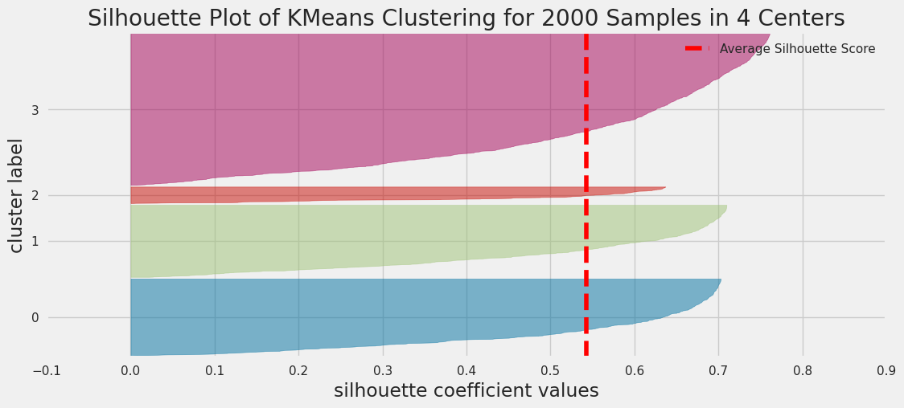
Model Results: Silhouette Score of K-Means Clusters

Slide 24
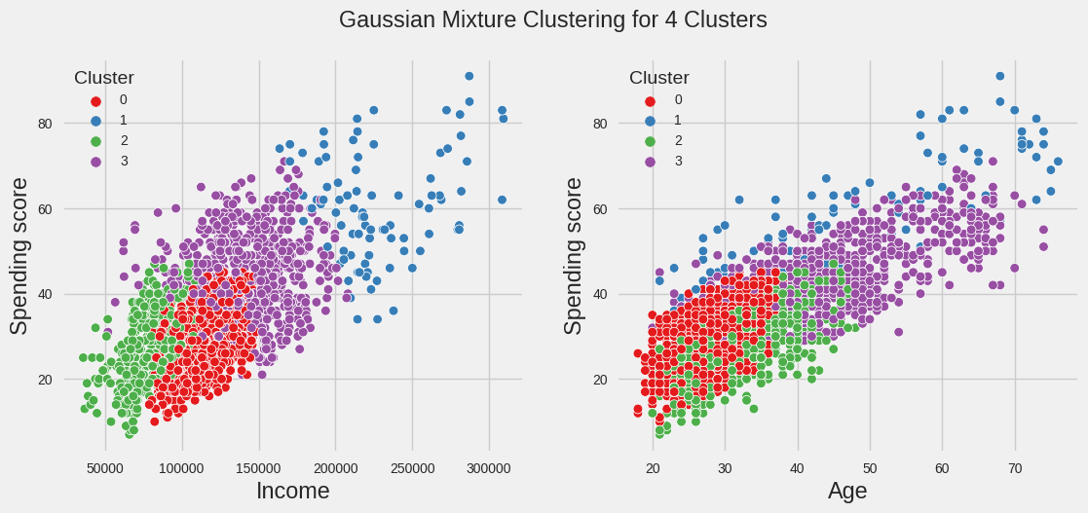
Model Results: Gaussian Mixture Clustering

Slide 25
Model Preparation: beating the established baseline
MAE of KNN Regressor in the Training Set: 0.21 degrees
MAE of KNN Regressor in the Test Set: 0.24 degrees
MAE of the established baseline: 2.03 degrees
Therefore, it was worthwhile to use machine learning algorithms on this regression problem.

Slide 26
Conclusions and Future Work

Slide 27
Conclusions
In this project, I used historical data from the Berkeley Earth Dataset to predict the Average Land and Surface Temperature using other temperature features.
As my target variable is continuous and I know the target and feature variables, I created a supervised regression machine learning model. I tested several supervised ML algorithms and found that the KNN regressor had the best performance metrics.
My model beat the established baseline of 2.03 degrees and accurately predicted the average temperature.

Slide 28
Real World Applications
My supervised machine learning problem is helpful for predicting average, minimum, or maximum temperature from historical data.
In the real world, I would like to use an existing dataset to predict future temperatures.
This requires forecasting time series data in the future. A well- known machine learning method would be implementing a Convolution Neural Network (CNN).
A good overview of the problem is described in this Medium post.

Slide 29
Additional Features for Temperature Forecasting
The National Oceanic and Atmospheric Administration tracks factors impacting temperature and climate. Further analysis can be performed after adding:
Latitude and Elevation
Nearness to center of large landmasses or bodies of water
Location relative to large mountain ranges
Humidity
Ocean Currents

Slide 30
Recommendations for further research
The Berkeley Earth Climate Change study includes separate data for Global Average Land Temperature by Country, Global Average Land Temperature by State, and Global Land Temperatures By City. A separate analysis could be performed on any of these datasets.
As the temperature data is in the form of time series, one could also use a Recurrent Neural Network (RNN) to predict feature temperatures. This would potentially use a GRU or LSTM. A simplified model on a different dataset is shown here.
Instead of predicting the average temperature, one could predict the causes of temperature change. This is an active area of research in machine learning.

Slide 31
Notebook Locations
A Jupyter notebook of my work can be found here.
The same notebook is also on Kaggle.

Slide 32
Machine Learning Competitions
Kaggle hosts a variety of machine learning competitions including predicting sales of house prices, natural language processing for disaster tweets, and classifying Arabic letters through images.
I would like to get more involved with the community and participate in competitions.
I am active in two ML Meetup groups and would like to become more active with the machine learning community in Ann Arbor (and elsewhere).

Slide 33
Questions/Discussion

